Slide 1
SUGAR GAME:
HIGHER OR LOWER
haMpShIrE SchOOl gaMES WEEK

Slide 2
hOW tO plaY
Similar to the TV game (Higher or Lower). It’s designed to get children thinking about the amount of sugar cubes found in some traditional sweet treats from counties across the Commonwealth.
The children will learn about 10 countries within the Commonwealth.
The aim of the game is to state whether they think the item has more or less sugar than the previous.

Slide 3
mOVE & plaY
Using commands: choose 2 commands, 1 for higher, 1 for lower. Pupils perform that command depending on their answer; (e.g. star jumps=higher, jog on spot=lower).
Using movement: in your space, pick a side to be higher & one to be lower. Pupils move to the side of their answer.
Guess the cubes: pupils form groups of those numbers, collect equipment of the value or use multi-link cubes.
To be played in the classroom, sports hall or outside.

Slide 4
lEt’S plaY
Click through the slides, we’ve given you the first one. Remember you need to state whether you think item number 2 has more or less sugar cubes than number 1

Slide 5
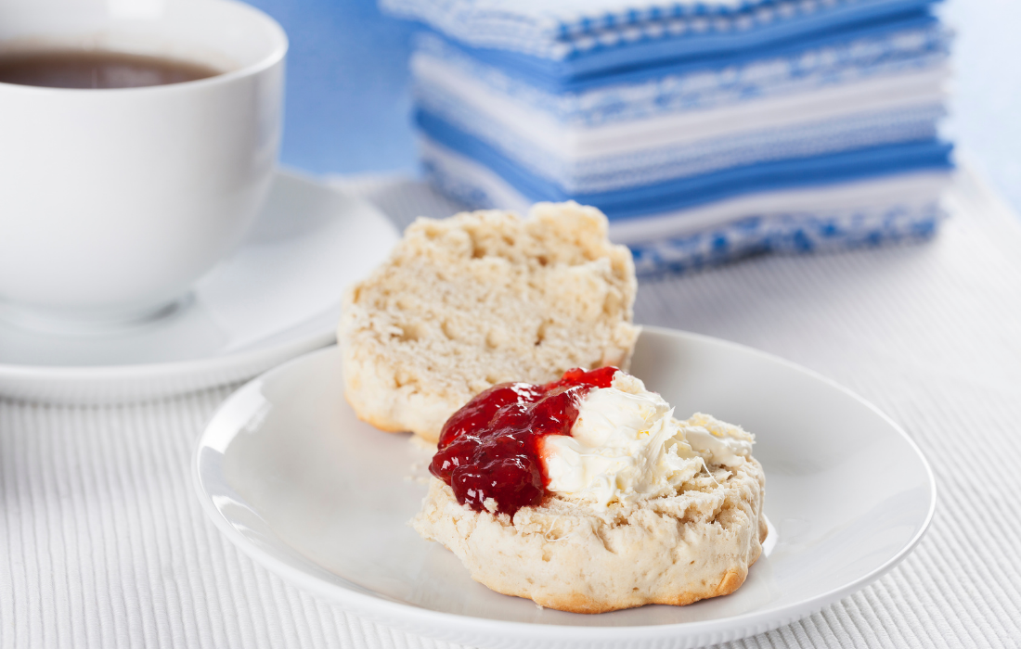
cOUntry 1 - UnItED KIngDOM
Afternoon cream team
…has 3.2 sugar cubes

Slide 6
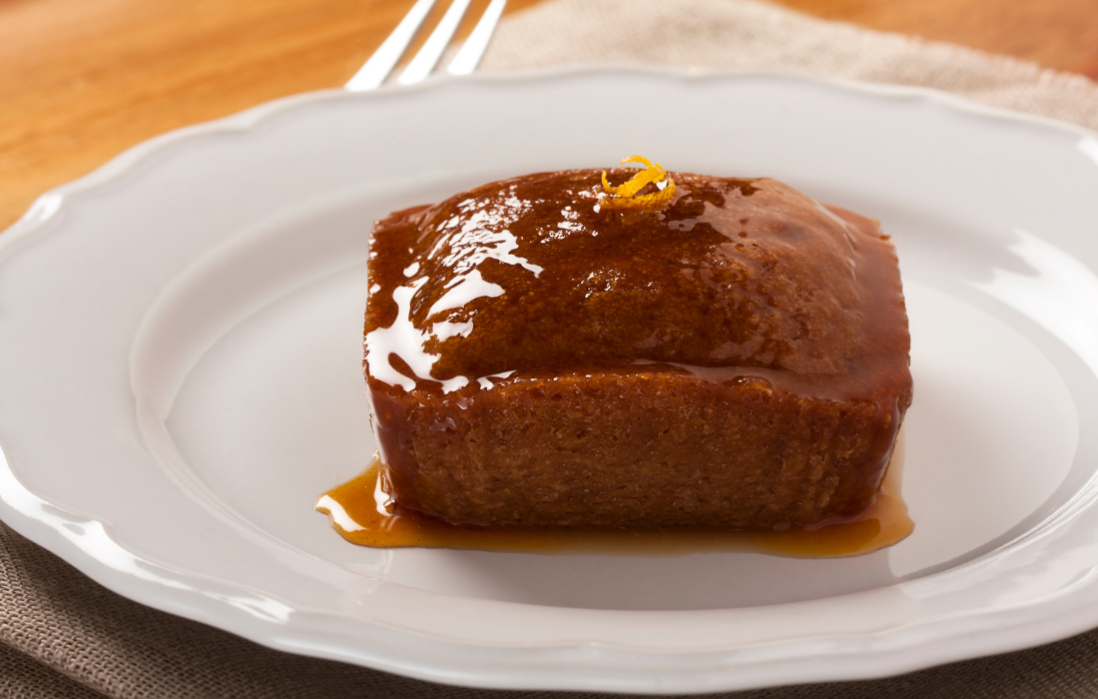
cOUntry 2 - SOUtH afrIca
Malva pudding is a sweet pudding of South African origin. It contains apricot jam and has a spongy caramelised texture.
Does it have higher or lower amount of sugar cubes than the United Kingdom Cream Tea?

Slide 7
cOUntry 2 - SOUtH afrIca
HIgHEr
It has 11.3 sugar cubes

Slide 8
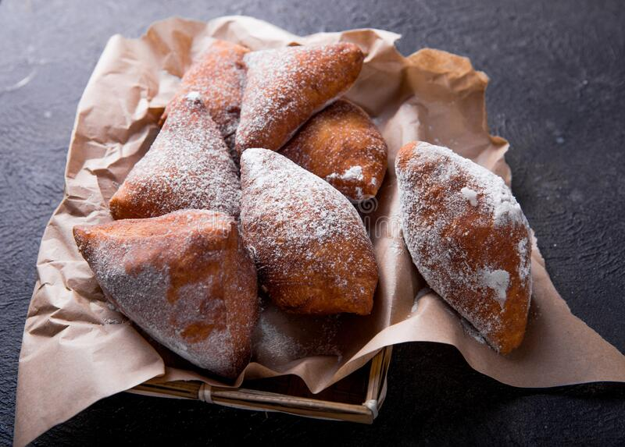
cOUntry 3 - KEnYa
Mandazi are similar to doughnuts. They are less sweet than the American donut, often made in a triangular shape
Does 5 pieces have higher or lower amount of sugar cubes than the South African Malva Pudding?

Slide 9
cOUntry 3 - KEnYa
lOWEr
It has 4.8 sugar cubes
(per serving, 5 pieces)

Slide 10
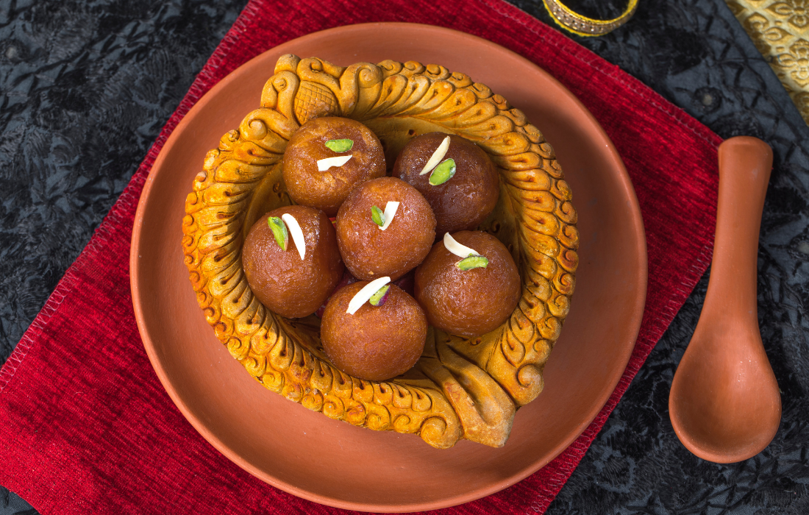
cOUntry 4 - InDIa
Gulab jamun is a milk-solid-based sweet
Does a serving (4 balls) have higher or lower amount of sugar cubes than the Kenyan Mandazi?

Slide 11
cOUntry 4 - InDIa
HIgHEr
It has 18 sugar cubes
(per serving, 4 balls)

Slide 12
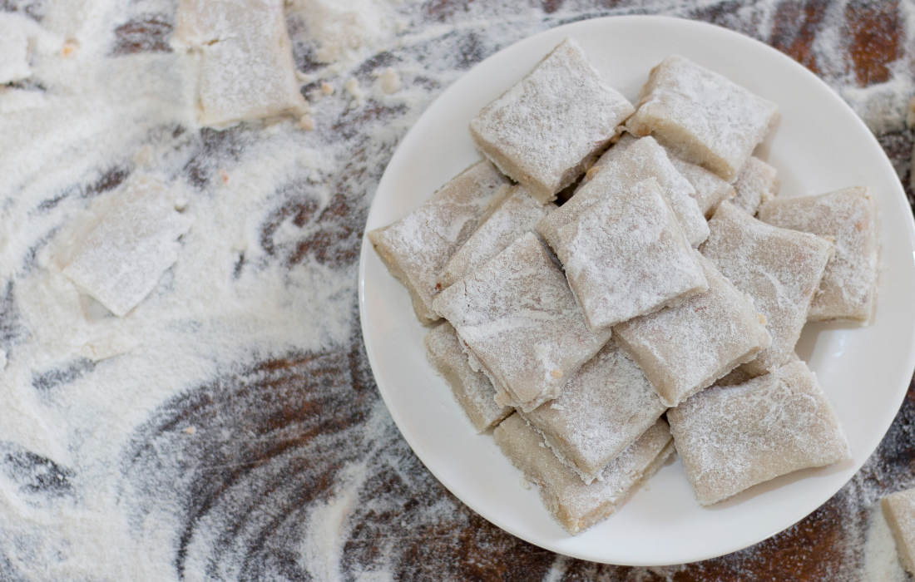
cOUntry 5 - SrI lanka
Aluwa is a Sri Lankan sweet. It is made from roasted rice flour or potatoes with boiled treacle, cashew nuts and cardamom and is served in a flat cookie-like form.
Does a serving (8 pieces) have higher or lower amount of sugar cubes than the Indian Gulab jamun?

Slide 13
cOUntry 5 - SrI lanka
lOWEr
It has 4.5 sugar cubes
(per serving, 8 pieces)

Slide 14
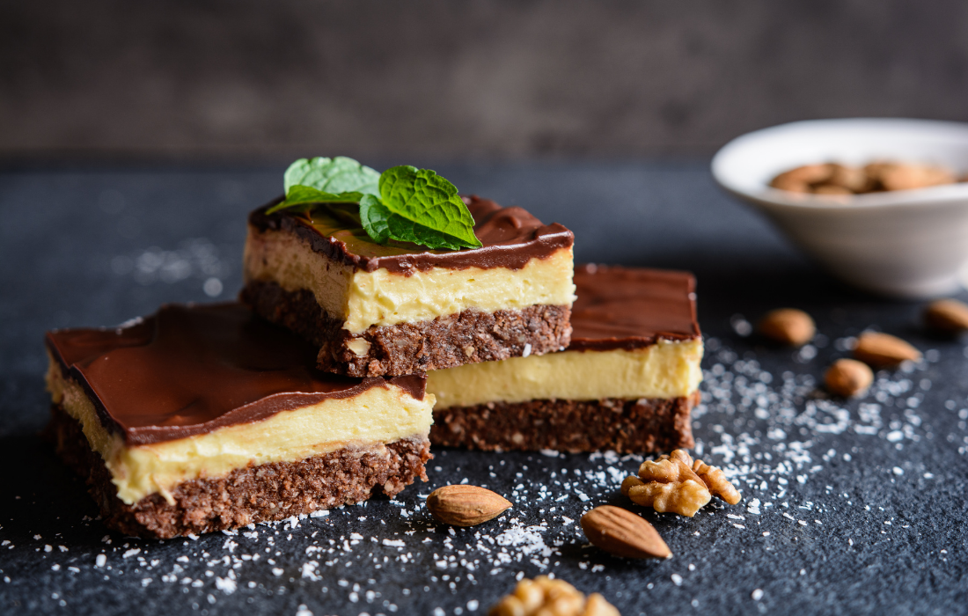
cOUntry 6 - canaDa
The Nanaimo bar is a bar dessert that requires no baking. It consists of three layers: a wafer, nut, & coconut crumb base; custard icing in the middle; & a layer of chocolate ganache on top
Does a serving (1 slice) have higher or lower amount of sugar cubes than the Sri Lankan Aluwa?

Slide 15
cOUntry 6 - canaDa
HIgHEr
It has 5.25 sugar cubes
(per serving, 1 slice)

Slide 16
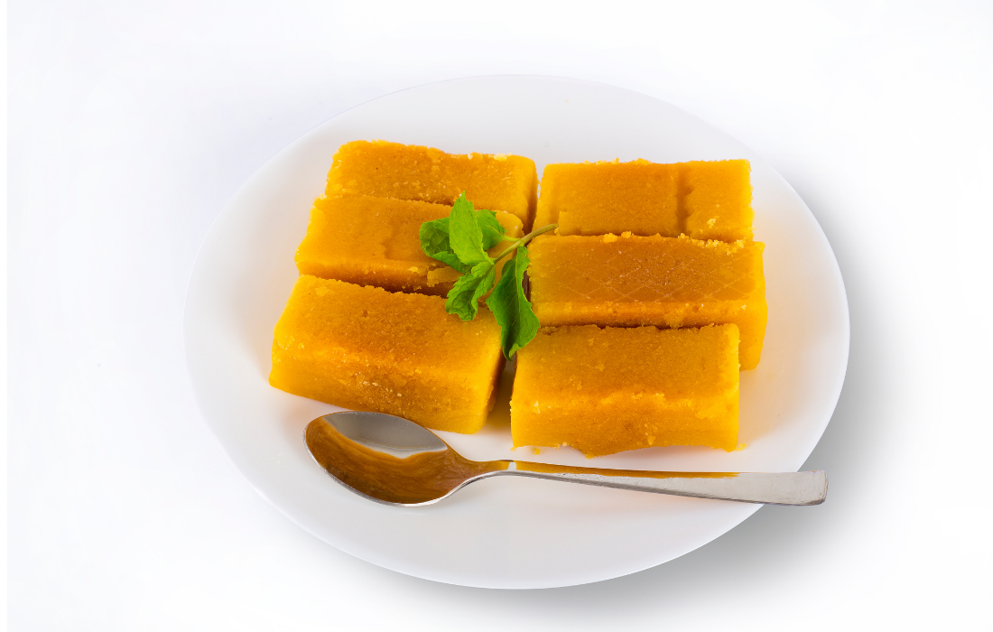
cOUntry 7 - BarBaDOS
Sugar Cake is made with coconut and sugar and baked in moulds. It is very popular amongst children and adults in Barbados.
Does a serving (1 cake) have higher or lower amount of sugar cubes than the Canadian Nanaimo bar?
Notes:
Not copyright free: Sugar Cake - Barbados Pocket Guide

Slide 17
cOUntry 7 - BarBaDOS
HIgHEr
It has 8.5 sugar cubes
(per serving, 1 cake)

Slide 18
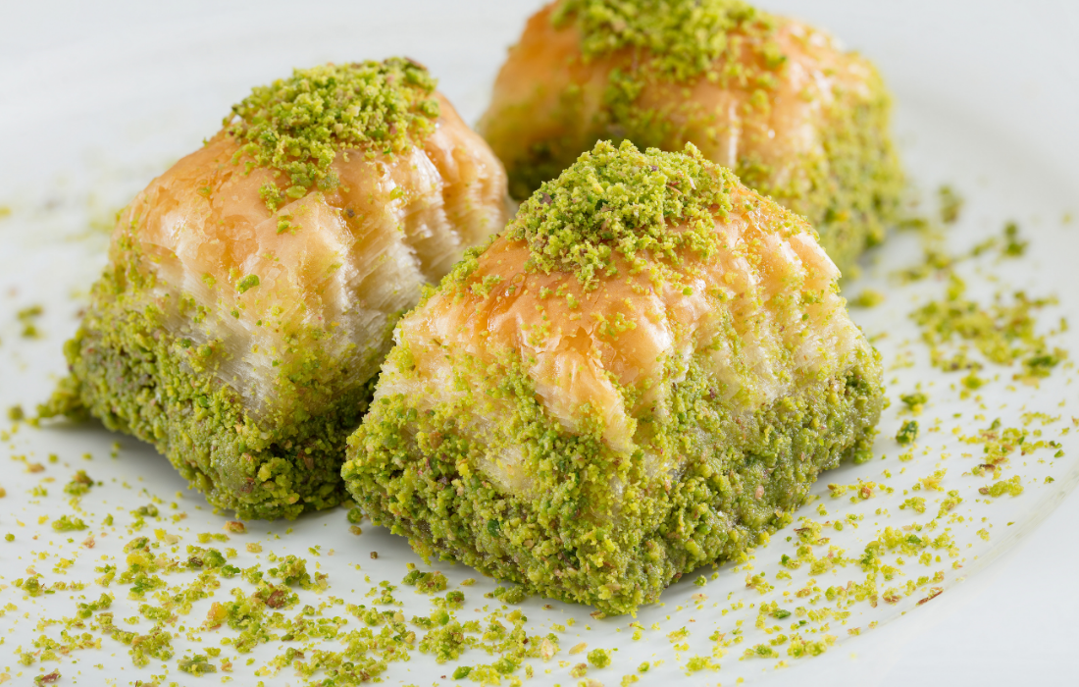
cOUntry 8 - cYprUS
Baklava is a rich, syrupy & buttery sweet made from layers of crispy pastry. The pastry usually contains a nut filling & the sweet taste comes from the sugar syrup or honey.
Does a serving (1 slice) have higher or lower amount of sugar cubes than the Bajun Sugar Cake?

Slide 19
cOUntry 8 - cYprUS
lOWEr
It has 4.25 sugar cubes
(per serving, 1 slice)

Slide 20
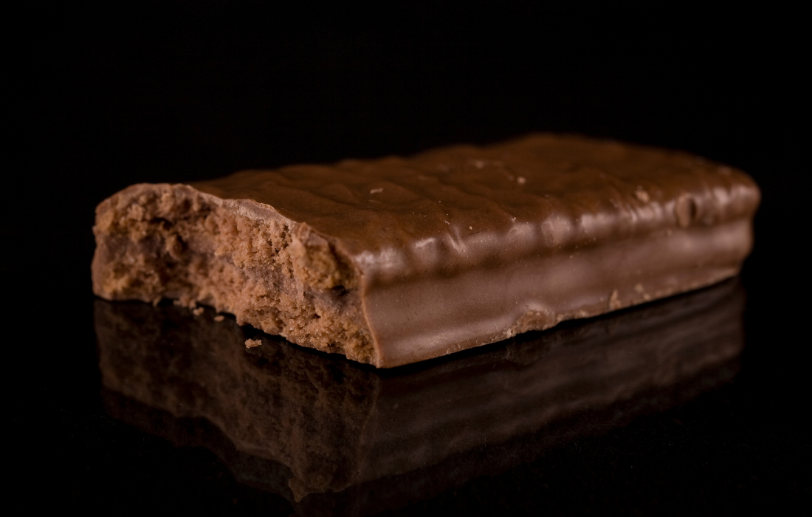
cOUntry 9 - aUStralIa
Tim Tam is a brand of chocolate biscuit. It consists of two malted biscuits separated by a light hard chocolate cream filling & coated in a thin layer of textured chocolate
Does a serving (1 biscuit) have higher or lower amount of sugar cubes than the Cyprus Baklava?

Slide 21
cOUntry 9 - aUStralIa
lOWEr
It has 2 sugar cubes
(per serving, 1 biscuit)

Slide 22
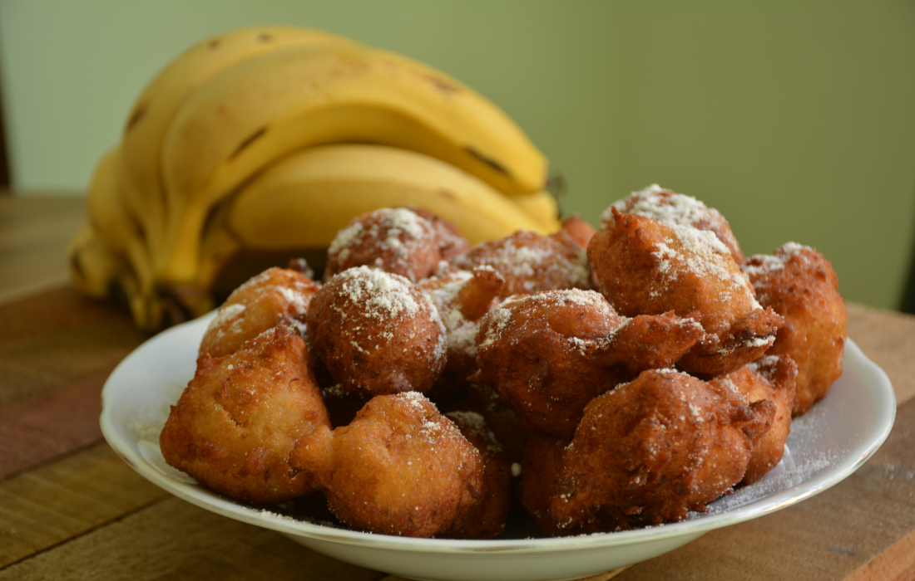
cOUntry 10 - tOnga
Faikakai Malimali is a Tongan dessert composed of banana dumplings in a sweet coconut syrup.
Does a serving (5 dumpling) have higher or lower amount of sugar cubes than the Australian Tim Tam?
Notes:
Not copyright free: Faikakai Malimali - Authentic Recipe from Tonga | 196 flavors

Slide 23
cOUntry 10 - tOnga
HIgHEr
It has 7.7 sugar cubes
(per serving, 5 dumplings)

Slide 24
all fInISHED
CONGRATULATIONS! You’re all finished!
How did you get on?
We hope you had fun learning about sweet treats from 10 different counties in the Commonwealth.

